Slide 1


Animation
Chris Piech
CS106A, Stanford University

Slide 2
You will be able to write Bouncing Ball

Slide 3

Learning Goals
Feel more confident writing methods
Write animated programs

Slide 4
Review

Slide 5
Boolean Variable
boolean karelIsAwesome = true;
boolean myBool = 1 < 2;

Slide 6


Slide 7
Is Square
public void run() {
for(int i = 1; i <= 100; i++) {
if( /*check if i is a square number*/ ) {
println(i);
}
}
}

Slide 8
Is Square
public void run() {
for(int i = 1; i <= 100; i++) {
if(isSquare(i)) {
println(i);
}
}
}

Slide 9

Boolean Return
public void run() {
for(int i = 1; i <= 100; i++) {
if(isSquare(i)) {
println(i);
}
}
}
private boolean isSquare(int x) {
double root = Math.sqrt(x);
if(root == Math.floor(root)) {
return true;
} else {
return false;
}
}

Slide 10
Boolean Return
public void run() {
for(int i = 1; i <= 100; i++) {
if(isSquare(i)) {
println(i);
}
}
}
private boolean isSquare(int x) {
double root = Math.sqrt(x);
return root == Math.floor(root);
}

Slide 11
Boolean Return
public void run() {
for(int i = 1; i <= 100; i++) {
if(isSquare(i)) {
println(i);
}
}
}
private boolean isSquare(int x) {
double root = Math.sqrt(x);
return root == (int)root;
}

Slide 12
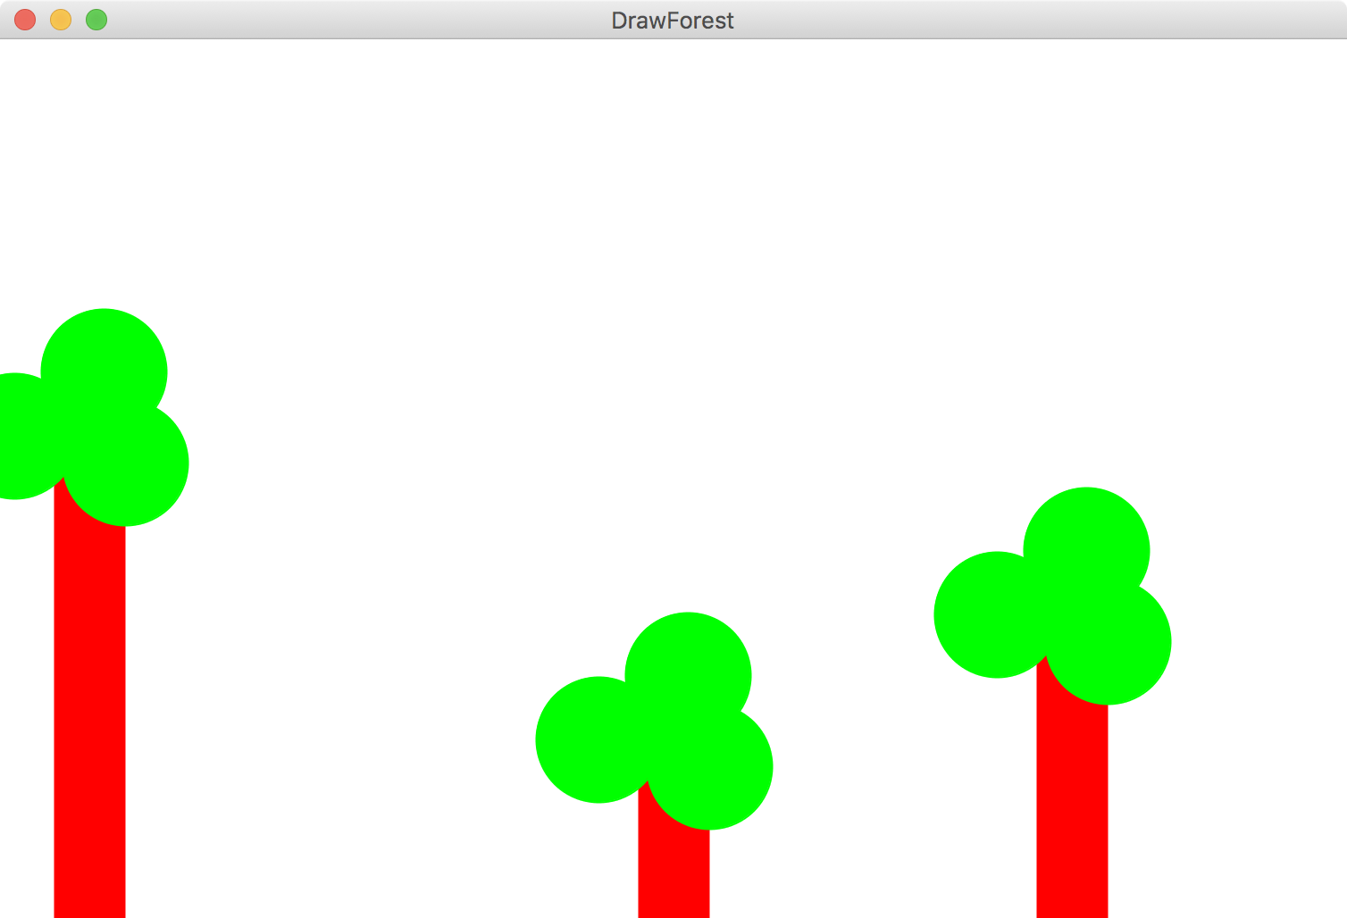

Slide 13
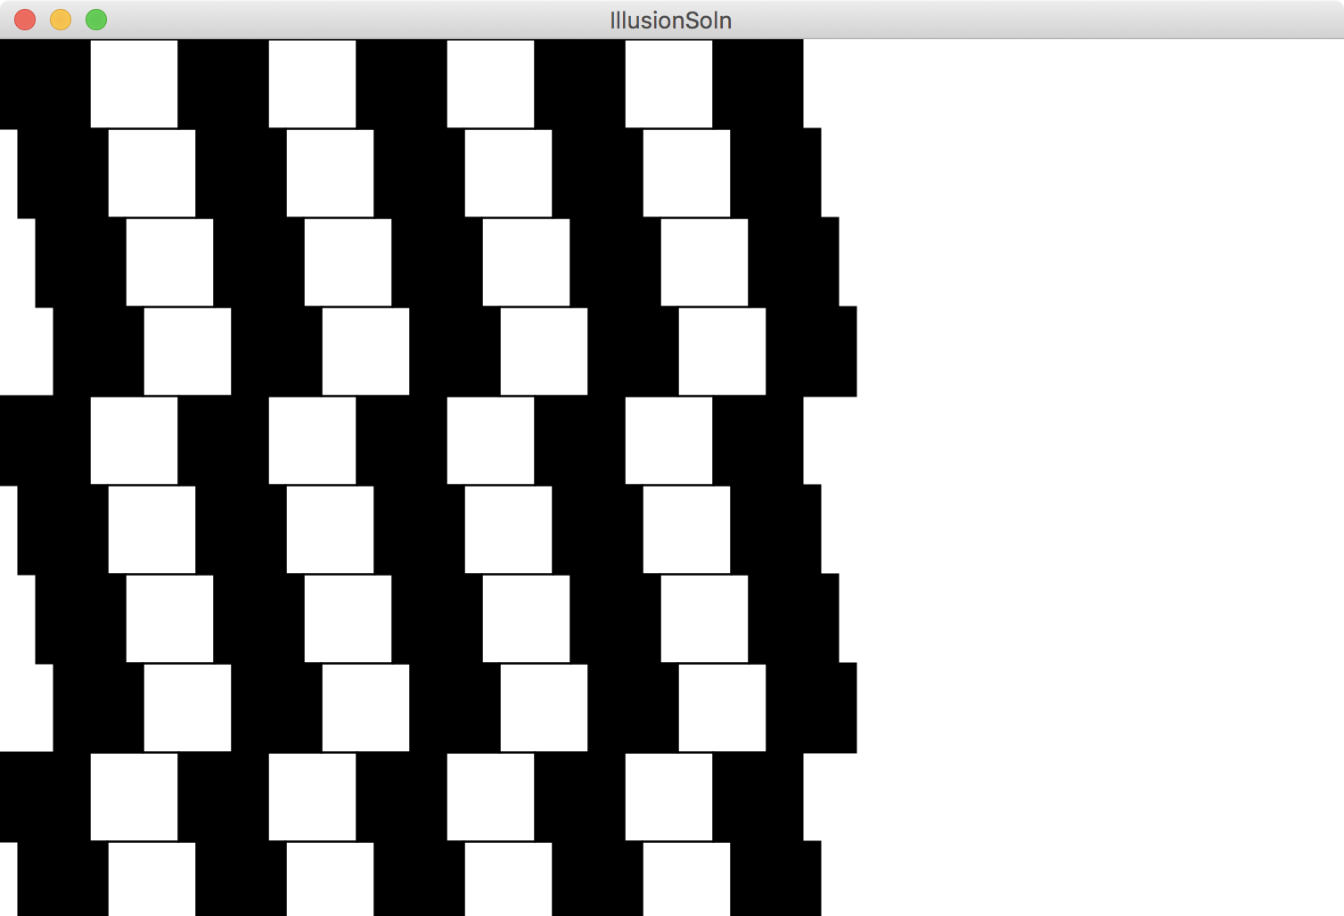

Slide 14
Great foundation

Slide 15
End Review

Slide 16
Move to Center

Slide 17
Animation Loop
private void run() {
// setup
while(true) {
// update world
// pause
pause(DELAY);
}
}

Slide 18
Animation Loop
private void run() {
// setup
while(true) {
// update world
// pause
pause(DELAY);
}
}
Make all the variables you need. Add graphics to the screen.

Slide 19
Animation Loop
private void run() {
// setup
while(true) {
// update world
// pause
pause(DELAY);
}
}
The animation loop is a repetition of heartbeats

Slide 20
Animation Loop
private void run() {
// setup
while(true) {
// update world
// pause
pause(DELAY);
}
}
Each heart-beat, update the world forward one frame

Slide 21
Animation Loop
private void run() {
// setup
while(true) {
// update world
// pause
pause(DELAY);
}
}
If you don’t pause, humans won’t be able to see it

Slide 22
Move To Center
private void run() {
// setup
GRect r = makeRect();
while(!isPastCenter(r))
// update world
r.move(1, 0);
// pause
pause(DELAY);
}
}

Slide 23
Bouncing Ball

Slide 24
Milestone #1

Slide 25
Bouncing Ball
First heartbeat
Velocity: how much the ball position
changes each heartbeat

Slide 26
Bouncing Ball
First heartbeat
vx
vy
The GOval move method takes in
a change in x and a change in y

Slide 27
Bouncing Ball
Second heartbeat
vx
vy

Slide 28
Bouncing Ball
Third heartbeat
vx
vy

Slide 29
Bouncing Ball
What happens when we hit a wall?

Slide 30
Bouncing Ball
We have this velocity
vx
vy

Slide 31
Bouncing Ball
Our new velocity
vy
vx
When reflecting vertically: vy = -vy

Slide 32
Bouncing Ball
Seventh heartbeat
vy
vx

Slide 33
Bouncing Ball
Eighth heartbeat
vy
vx

Slide 34
Bouncing Ball
Ninth heartbeat
vy
vx

Slide 35
Bouncing Ball
We want this!

Slide 36
Bouncing Ball
This was our old velocity
vy
vx

Slide 37
Bouncing Ball
This is our new velocity
vy
vx
When reflecting horizontally: vx = -vx

Slide 38
Bouncing Ball
Tenth heartbeat
vy
vx
When reflecting horizontally: vx = -vx

Slide 39
Bouncing Ball

Slide 40
A Sticky Situation
This is our new velocity
The ball is above the bottom so we reverse its vy
The ball is bellow the bottom so we reverse its vy

Slide 41
Learning Goals
Feel more confident writing methods
Write animated programs

Slide 42
Novelty

Slide 43
Random Numbers
// this variable can make random numbers
RandomGenerator rg = new RandomGenerator();
// make a random number between 0 and 5
int randNum = rg.nextInt(6);

Slide 44

Random Numbers Theory
Last random number
Next random number
// actual code from the java library
int nextseed = (oldseed * multiplier + addend) % max;
Fun fact: the first random number comes from the CPU clock
* Just for fun. Not on exams or psets…

Slide 45
Random Numbers
// this variable can make random numbers
RandomGenerator rg = new RandomGenerator();
// now each run will be the same…
rg.setSeed(0);
// make a random number between 0 and 5
int randNum = rg.nextInt(6);

